Slide 1
AGENDA
INSTALLATION
EF CORE
MIGRATION
LINKS

Slide 2
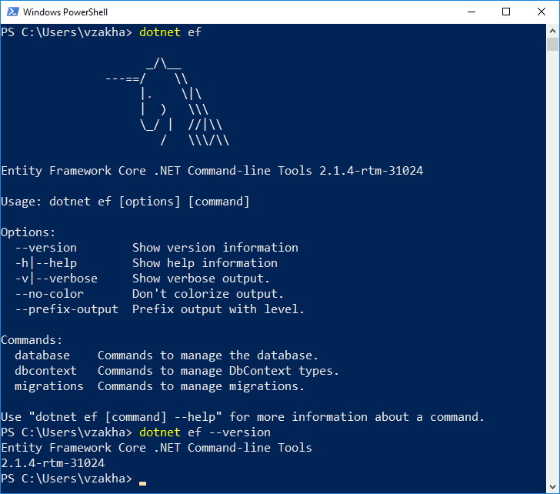
Installation
NuGet packages
Microsoft.EntityFrameworkCore.SqlServer
Microsoft.EntityFrameworkCore.Tools
- dotnet add package
- Install-Package

Slide 3

EF Core
Database drivers:
SQL Server
SQLite
PostgreSQL

Slide 4
Migrations
EF Core provides simple way of keeping your EF Core model and database schema in sync.
EF Core model (Migrations)
database schema (Reverse Engineering)
Add-Migration InitialCreate
Update-Database
Script-Migration
Update-Database <name>
Remove-Migration
Update-Database

Slide 5
Links
Manual
https://metanit.com/sharp/entityframeworkcore/
Examples
https://www.youtube.com/watch?v=zHdzpO24EbY
https://www.youtube.com/watch?v=RrOPUegE8MI
https://www.youtube.com/watch?v=Gbhlo_Q4VXo&t=77s

